Slide 1
CNN-LSTM Based Model for ECG Arrhythmias and Myocardial Infarction Classification
Name :ANJALYKRISHNA A S
Batch:A
Roll No:22
Project Guide:Ms.Joice T

Slide 2
OBJECTIVE
Develop an automated system to classify ECG signals into Myocardial Infarction (MI), Abnormal Heartbeat, and Normal signals with high precision.
Implement a 1D CNN-LSTM model to extract spatial features (CNN) and capture temporal patterns (LSTM) for comprehensive ECG signal analysis.
Enhanced Medical Diagnostics Provide a reliable, scalable tool to assist cardiologists in detecting and monitoring heart conditions, reducing human error and improving diagnostic accuracy.
2 of 10

Slide 3
EXISTING SYSTEM
Manual Diagnosis:ECG analysis by cardiologists is time-consuming, error-prone, and depends on expert availability.
Limited Use of Advanced Models: Many systems rely on traditional machine learning or basic Autoencoder models that may not capture complex ECG patterns effectively.
Single-Method Approaches:Existing models use either CNNs or LSTMs, limiting comprehensive analysis of both spatial and temporal features.
Suboptimal Accuracy: Existing methods may struggle to provide high precision and reliability, particularly for diverse arrhythmia types.
Standalone CNN Models: ~88-94% (effective in feature extraction but lacks temporal understanding)
Standalone LSTM Models: ~86-93% (captures temporal dependencies but may miss spatial features
3 of 10

Slide 4
PROPOSED SYSTEM
Hybrid CNN-LSTM Approach:
The proposed system integrates CNNs for spatial feature extraction
LSTMs for capturing temporal dependencies
providing a comprehensive analysis of both the structure and time-based changes in ECG signals.
High Accuracy:CNN-LSTM method can improve the accuracy rates
98.1% accuracy for Myocardial Infarction (MI) classification.
98.66% accuracy for arrhythmia classification.
Real-Time Predictions: The system enables real-time ECG signal analysis, allowing for immediate detection and classification of arrhythmias and myocardial infarction, facilitating timely medical intervention.
4 of 10

Slide 5
SYSTEM DESIGN
Data Processing Module
Preprocess raw ECG data by handling missing values, normalizing amplitudes, and segmenting signals into uniform lengths.
Extract key features like waveforms, peaks, and intervals, or format the data directly for model input.
Training Module
Train the 1D CNN-LSTM model on ECG data for classifying conditions such as Myocardial Infarction, Abnormal Heartbeat, and Normal.
Split data into balanced training and testing sets, using CNN for spatial feature extraction and LSTM for temporal dependencies
5 of 10

Slide 6
Testing Module
Test the CNN-LSTM model on unseen ECG data and calculate performance metrics like accuracy, precision, recall, F1-score, and AUC-ROC.
Analyze the confusion matrix to identify misclassified cases and refine the model as necessary.
Classification Module
Classify new ECG signals into one of three categories: Myocardial Infarction, Abnormal Heartbeat, or Normal.
Input new ECG data into the trained model and output predictions in real time.
6 of 10

Slide 7
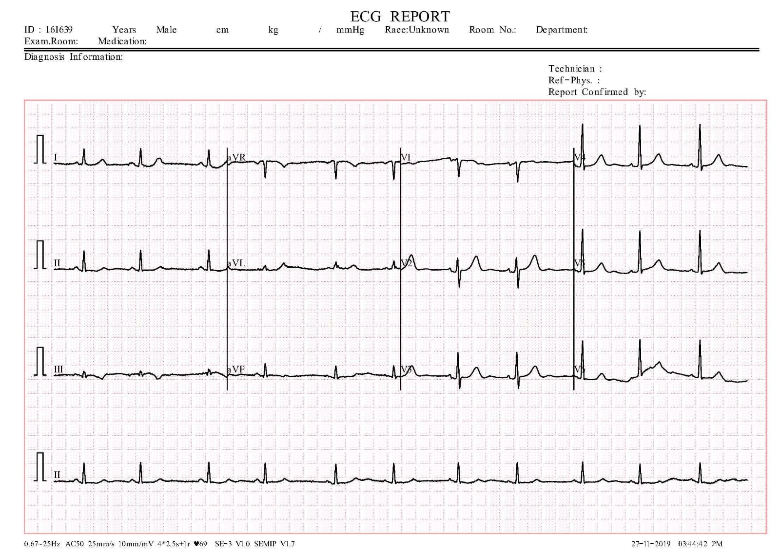
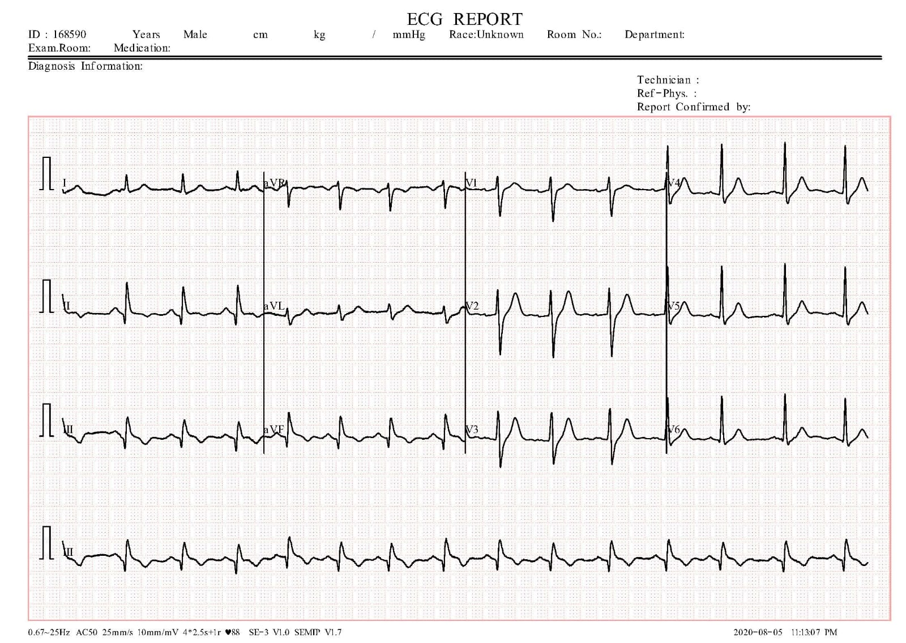
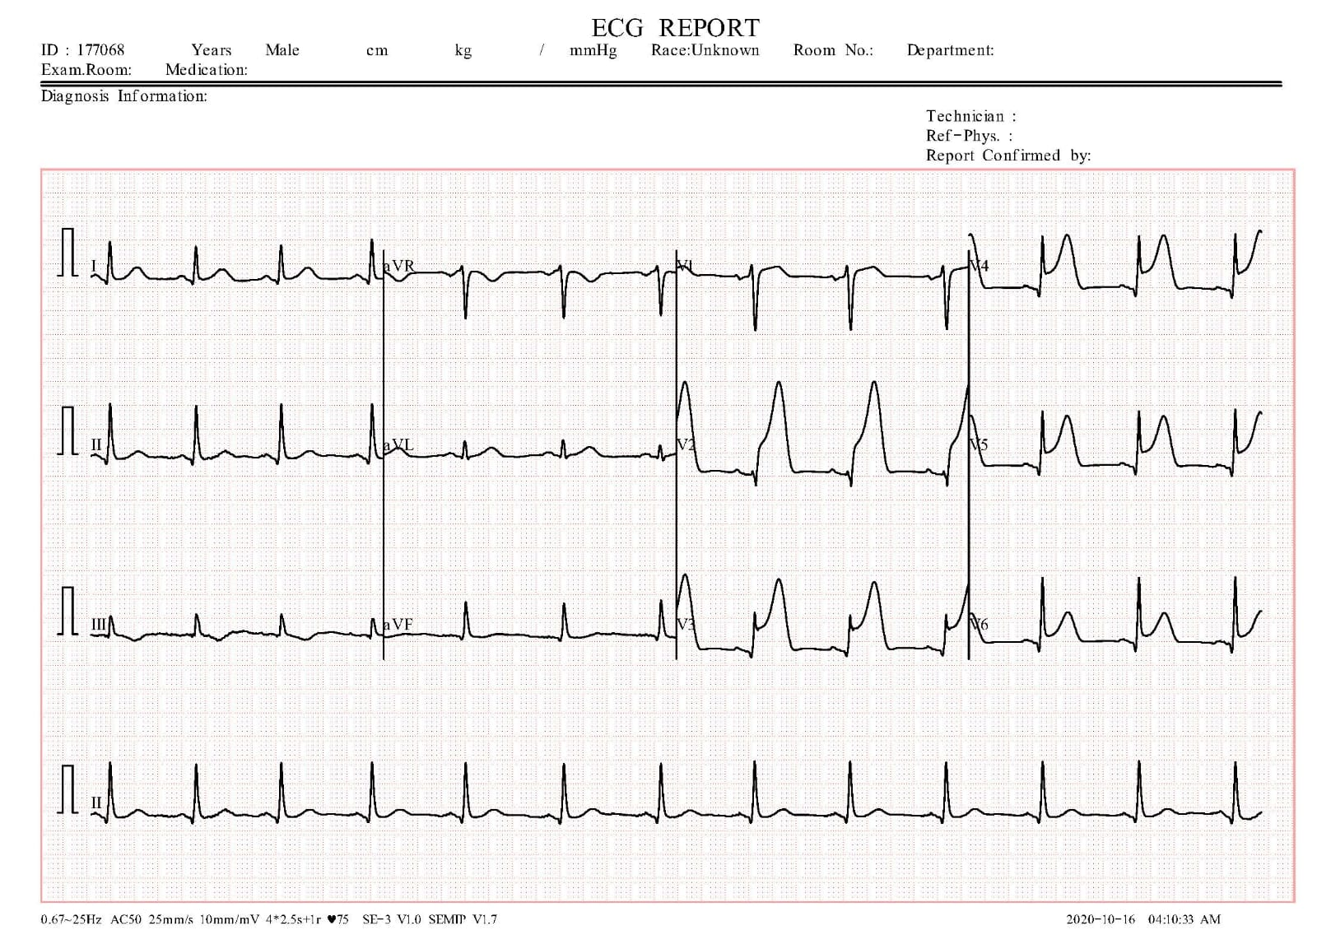
NORMAL
ABNORMAL
Myocardial Infarction
7 of 10

Slide 8
TOOLS AND TECHNOLOGIES
Programming Language: Python
Libraries: NumPy, Pandas, Scikit-learn, Matplotlib, Seaborn, TensorFlow, Keras
Algorithms: 1D Convolutional Neural Networks (CNN), Long Short-Term Memory (LSTM)
Deployment: Flask or FastAPI for building the real-time ECG classification interface
Dataset: cardiovascular ECG Images dataset(Kaggle)
8 of 10

Slide 9
REFERENCES
[1] Abdullah, Lana Abdulrazaq, and Muzhir Shaban Al-Ani. "CNN-LSTM based model for ECG arrhythmias and myocardial infarction classification." Adv. Sci. Technol. Eng. Syst 5.5 (2020): 601-606.
[2] Liu, Pengfei, et al. "Arrhythmia classification of LSTM autoencoder based on time series anomaly detection." Biomedical Signal Processing and Control 71 (2022): 103228.
[3] Rai, Hari Mohan, and Kalyan Chatterjee. "Hybrid CNN-LSTM deep learning model and ensemble technique for automatic detection of myocardial infarction using big ECG data." Applied Intelligence 52.5 (2022): 5366-5384.
9 of 10

Slide 10
THANK YOU
10 of 10

